Slide 1
Blind estimation of acoustic transfer functions (ATFs) and dereverberation based on convolutive transfer functions (CTFs) Date：2022. 10. 04
Telecom Electroacoustics Audio(TEA) Lab
Presenter:
Anchi Yuan
Notes:
Hello everyone
I’m today’s presenter siang. I’m going to share some of my present work in source separation problem. My topic is comparative studies of source separation using semi-blind and blind source separation approaches.

Slide 2
Outline
Kalman algorithm applied to adaptive filter (stationary)
Kalman algorithm applied to adaptive filter (nonstationary)
Simulation setting
Simulation result

Slide 3
Kalman algorithm applied to adaptive filter (stationary)

Slide 4
Kalman algorithm applied to adaptive filter (nonstationary)

Slide 5
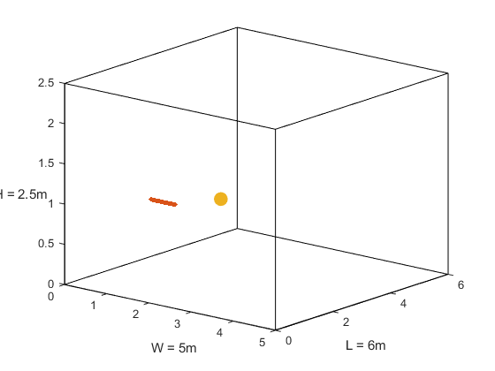

Simulation setting
Uniform linear array (ULA)
Number of microphones = 30
Spacing = 0.02m (2cm)
Aperture = (30-1)*0.02 = 0.58 m
Room size = 5m $×$6m $×$2.5m
Sampling frequency = 16kHz
Reverberation time T₆₀ =0.4s, 0.6s, 0.8s and 1.0s
First mic (1, 1.5, 1)
Source (2, 2.6, 1)
mic spacing = 0.02m
z
y
x

Slide 6
Simulation result
ATF matching error
T₆₀ (s) Method | 0.4 | 0.6 | 0.8 | 1.0
Proposed Wiener filter method | 0.1089 | 0.147 | 0.179 | 0.2002
Proposed RLS method | 0.1096 | 0.1484 | 0.184 | 0.2049
Kalman filter stationary | 0.1049 | 0.1433 | 0.1763 | 0.1966
Kalman filter nonstationary | 0.1051 | 0.1446 | 0.1872 | 0.2035

Slide 7
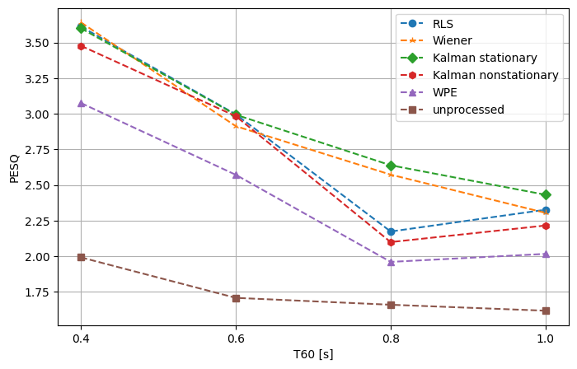
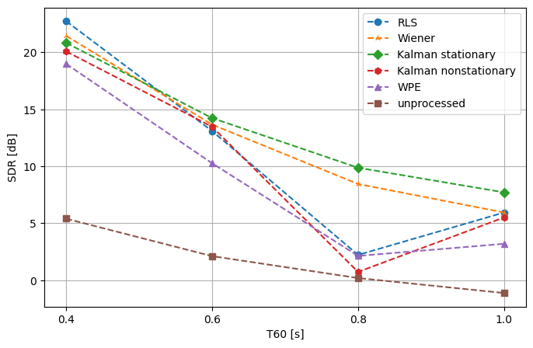
Simulation result
PESQ
SDR

Slide 8

Simulation result
 | Ground-truth source | Microphone received | WPE | Kalman stationary (MINT) | Kalman nonstationary (MINT)
T₆₀ = 0.6s
T₆₀ = 0.8s
T₆₀ = 1.0s

Slide 9


